Slide 1


Slide 2

#LifeKoKaroLift
SGC Coaching:
Articulate your Journey | Activate Students’ Vigour| Accelerate Mutual Growth
JumpStart to an engaging session with your group!
using these slides for reference

Slide 3
Agenda: Session 7
Classification model –(5 mins)
Focused Teaching –(55 mins)
Decision trees, Random Forest and Bagging
Confusion matrix
Doubt resolution –(30 mins)
Discuss - Notebooks

Slide 4

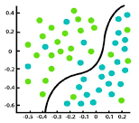
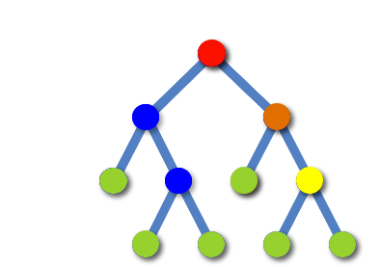
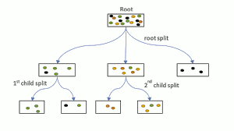
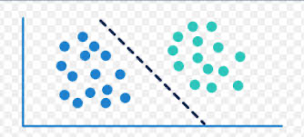
Focussed Teaching: Classification model Decision trees
Supervised learning
Goal is to separate the classes
Decision trees
CART CHAID TREES
Target variable
These are Classes
Convert continuous into target variable
Goal separate the classes
We can use any form of separator
Many methods predict Y value – at a threshold of 0.5 the classes are separated
Trees split the target variable
Basis the predictor value splits
CART gives only binary trees/ regression solution
Notes:
Ask this particularly in Non-Technical / Non-Experienced groups

Slide 5
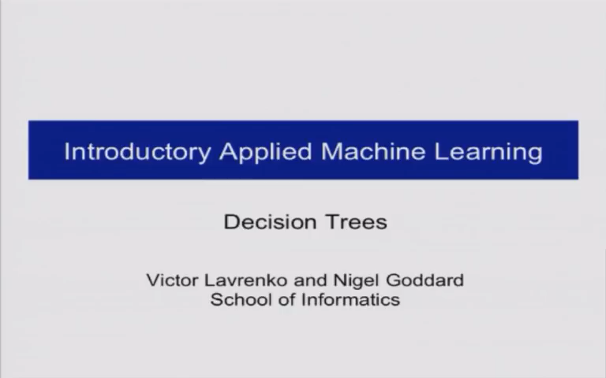
Focussed Teaching : Decision tree logic

Slide 6
Focussed Teaching : Decision tree logic
A general algorithm for a decision tree can be described as follows:
Pick the best attribute/feature. The best attribute is one which best splits or separates the data.
Ask the relevant question.
Follow the answer path.
Go to step 1 until you arrive to the answer.
The best split is one which separates two different labels into two sets.
Decision trees divide the feature space into axis-parallel rectangles or hyperplanes

Slide 7
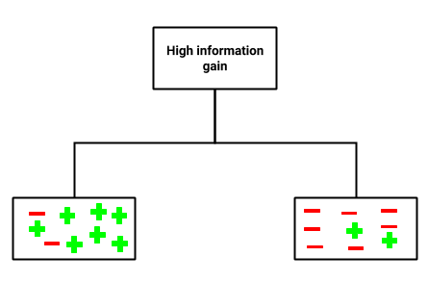
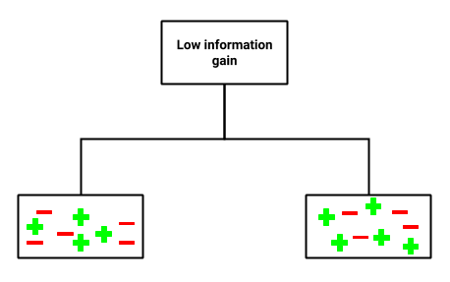


Focussed Teaching : Decision tree logic
Information gain is a statistical property that measures how well a given attribute separates the training examples according to their target classification
Check for more features at https://scikit-learn.org/stable/modules/generated/sklearn.tree.DecisionTreeClassifier.html

Slide 8
Focussed Teaching : Decision tree - code along
#Importing required libraries import pandas as pd import numpy as np from sklearn.datasets import load_iris from sklearn.tree import DecisionTreeClassifier from sklearn.model_selection import train_test_split
#Loading the iris data
data = load_iris()
print('Classes to predict: ', data.target_names)
#Extracting data attributes
X = data.data
### Extracting target/ class labels
y = data.target
print('Number of examples in the data:', X.shape[0])
#Using the train_test_split to create train and test sets. X_train, X_test, y_train, y_test = train_test_split(X, y, random_state = 47, test_size = 0.25)
#Importing the Decision tree classifier from the sklearn library.
from sklearn.tree import DecisionTreeClassifier
clf = DecisionTreeClassifier(criterion = 'entropy’)
#Training the decision tree classifier.
clf.fit(X_train, y_train)
#Predicting labels on the test set.
y_pred = clf.predict(X_test)
#Importing the accuracy metric from sklearn.metrics library
from sklearn.metrics import accuracy_score
print('Accuracy Score on train data: ', accuracy_score(y_true=y_train, y_pred=clf.predict(X_train)))
print('Accuracy Score on test data: ', accuracy_score(y_true=y_test, y_pred=y_pred))
clf = DecisionTreeClassifier(criterion='entropy', min_samples_split=50)
clf.fit(X_train, y_train)
print('Accuracy Score on train data: ', accuracy_score(y_true=y_train, y_pred=clf.predict(X_train)))
print('Accuracy Score on the test data: ', accuracy_score(y_true=y_test, y_pred=clf.predict(X_test)))
#Output: Out: Accuracy Score on train data: 0.9553571428571429 Accuracy Score on test data: 0.9736842105263158

Slide 9
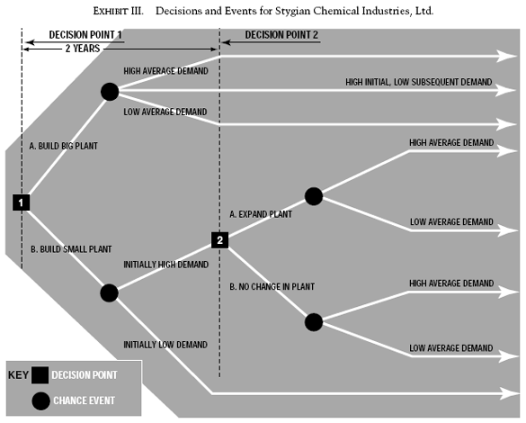
Focussed Teaching: Business case study Check the HBR article
The management of a company that I shall call Stygian Chemical Industries, Ltd., must decide whether to build a small plant or a large one to manufacture a new product with an expected market life of ten years.
Pls refer to article : https://hbr.org/1964/07/decision-trees-for-decision-making
Notes:
Ask this particularly in Non-Technical / Non-Experienced groups

Slide 10
Focussed teaching: Decision trees - Pros and Cons
Pros | Cons
Easy to use | Prone to overfitting
Can handle both categorical and numerical data | Need a measurement as to how well they are doing
Resistant to outliers | Need to be careful with parameter tuning
New features can be easily added | Can create biased learned trees
We can limit the tree growth by specifying the number of branches, min samples for split and min samples for a leaf node – called pruning of decision trees
This will to a level provide us a better solution

Slide 11
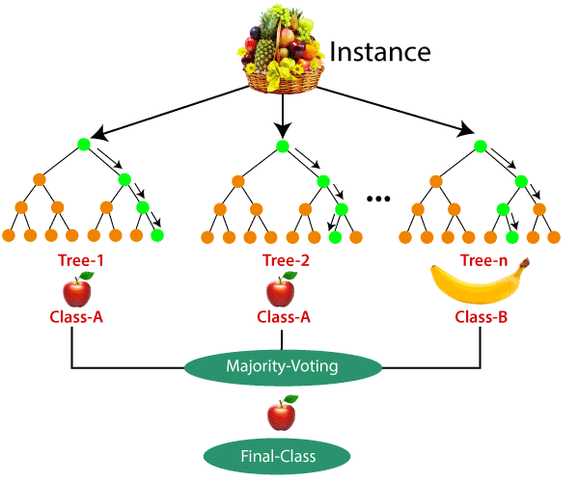
Focussed Teaching : Ensemble model Random Forest
Rather than depending one decision tree lets create a lot of trees and take the best result
This will be a good solution that is not an overfit solution
This is called an ensemble methodology – this ML is Random Forest
Random Forest logic
Notes:
For those who have less coding background, elaborate on the importance of coding along with the fact that logic and solutions are more important.
For people who feel “ I don’t want to do coding”, explain its relevance and the overall picture of a data scientist role to allay their fears.

Slide 12
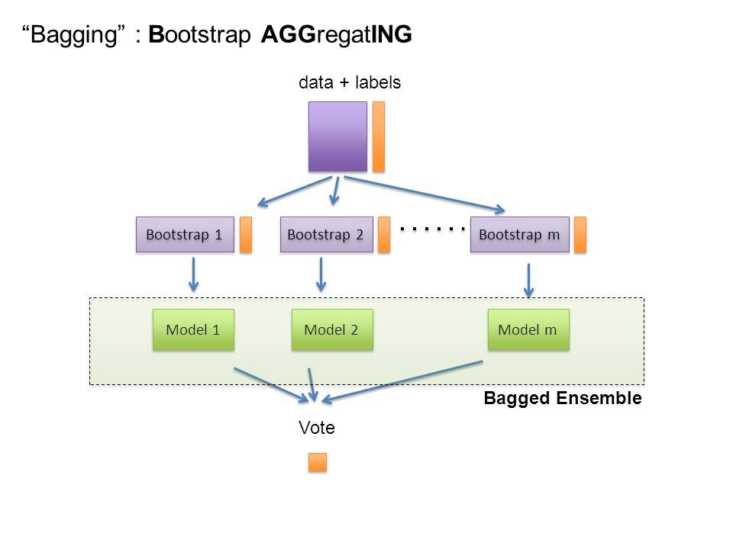
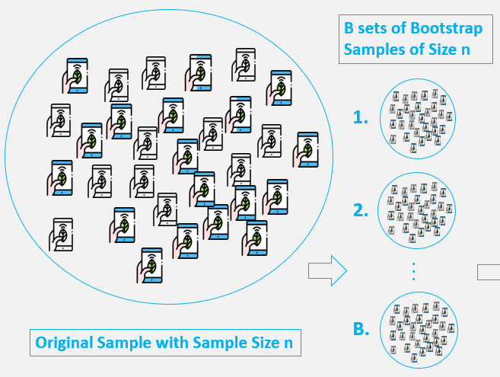
Focussed Teaching : Ensemble model Bagging
Rather than depending one decision tree lets create a lot of trees we will aggregate the solution
This is called an ensemble methodology
We can create a variety of data using Bootstrapping
Notes:
For those who have less coding background, elaborate on the importance of coding along with the fact that logic and solutions are more important.
For people who feel “ I don’t want to do coding”, explain its relevance and the overall picture of a data scientist role to allay their fears.

Slide 13
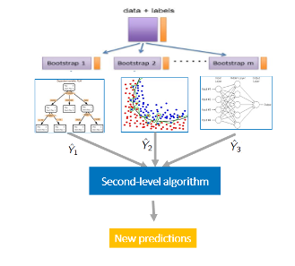
Focussed Teaching : Ensemble model Blending
Rather than depending on decision trees and taking a vote, we can use two sets of algorithm
1/ first level – for ML
2/ second level – in place of voting
Notes:
For those who have less coding background, elaborate on the importance of coding along with the fact that logic and solutions are more important.
For people who feel “ I don’t want to do coding”, explain its relevance and the overall picture of a data scientist role to allay their fears.

Slide 14
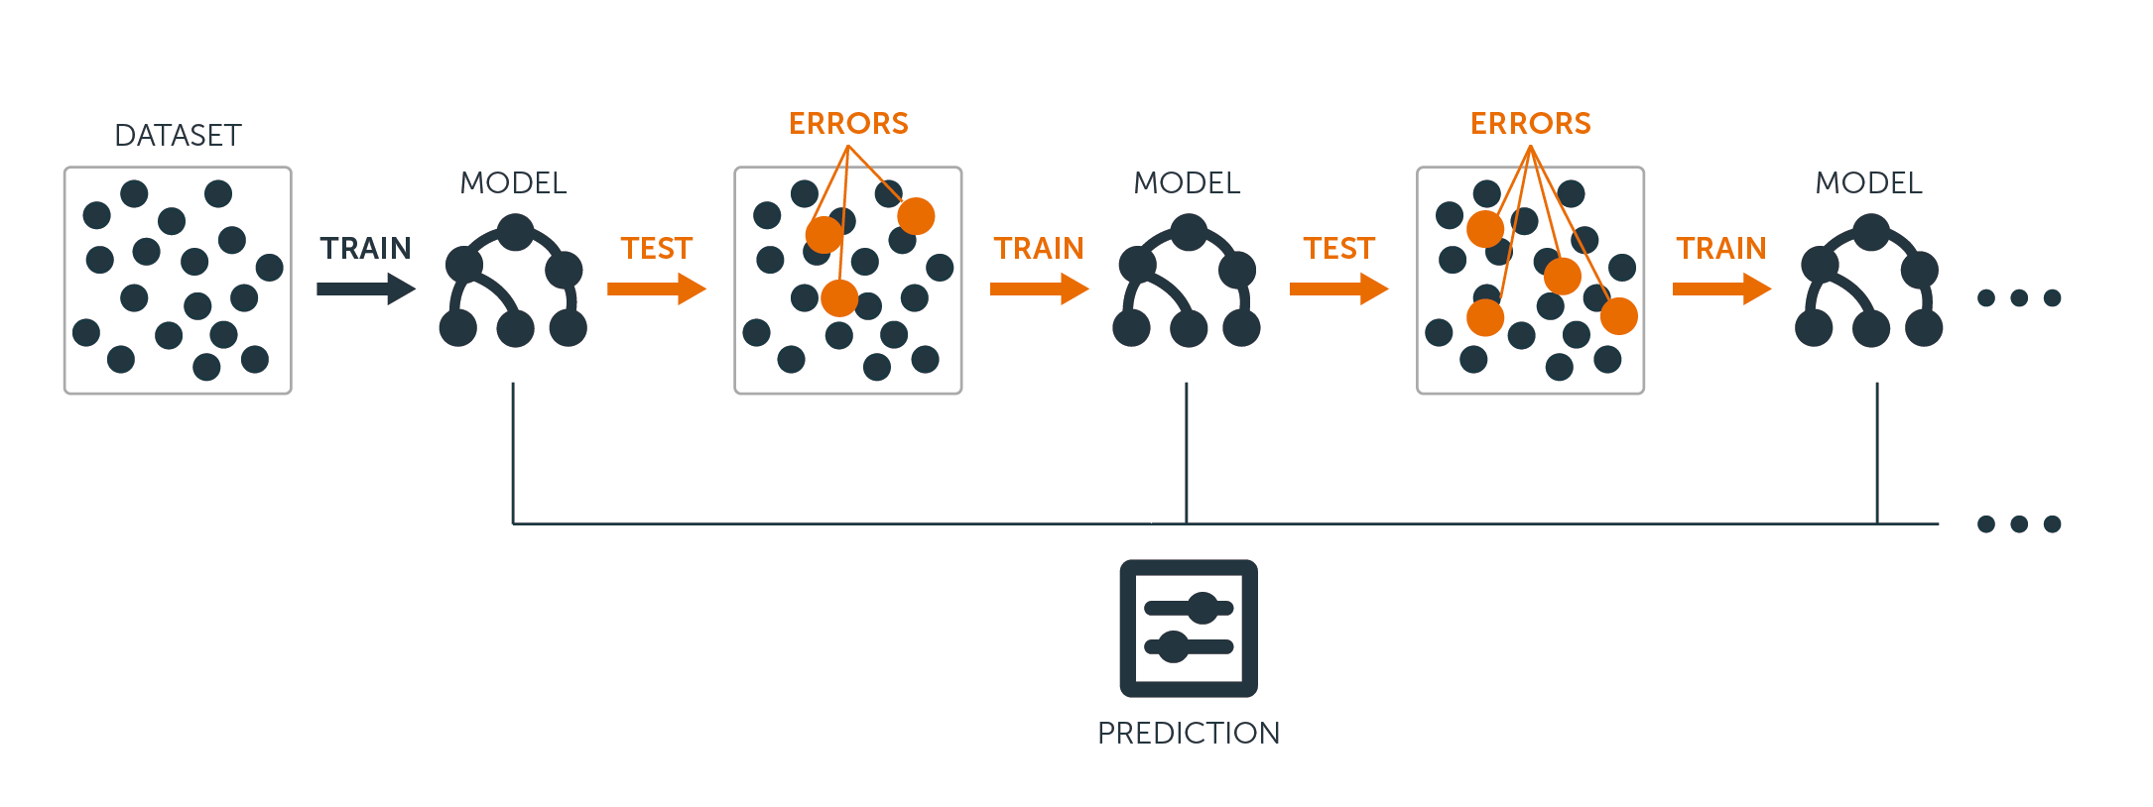
Focussed Teaching : Ensemble model Boosting
We can use decision trees to improve performance
The initial model – weak learners can be combined to give a high performing prediction
This works by reducing errors (y predicted vis-à-vis y actual)
These are called Boosting algorithm
We have 3 boosting methods – ADA Boost , Gradient Boost & XG Boost
Notes:
For those who have less coding background, elaborate on the importance of coding along with the fact that logic and solutions are more important.
For people who feel “ I don’t want to do coding”, explain its relevance and the overall picture of a data scientist role to allay their fears.

Slide 15

Personalized Feedback and Doubt resolution
Address individual concerns and provide specific feedback on their notebooks
What are they missing?
What can they do better?
Doubt Resolution
Questions??

